Slide 1
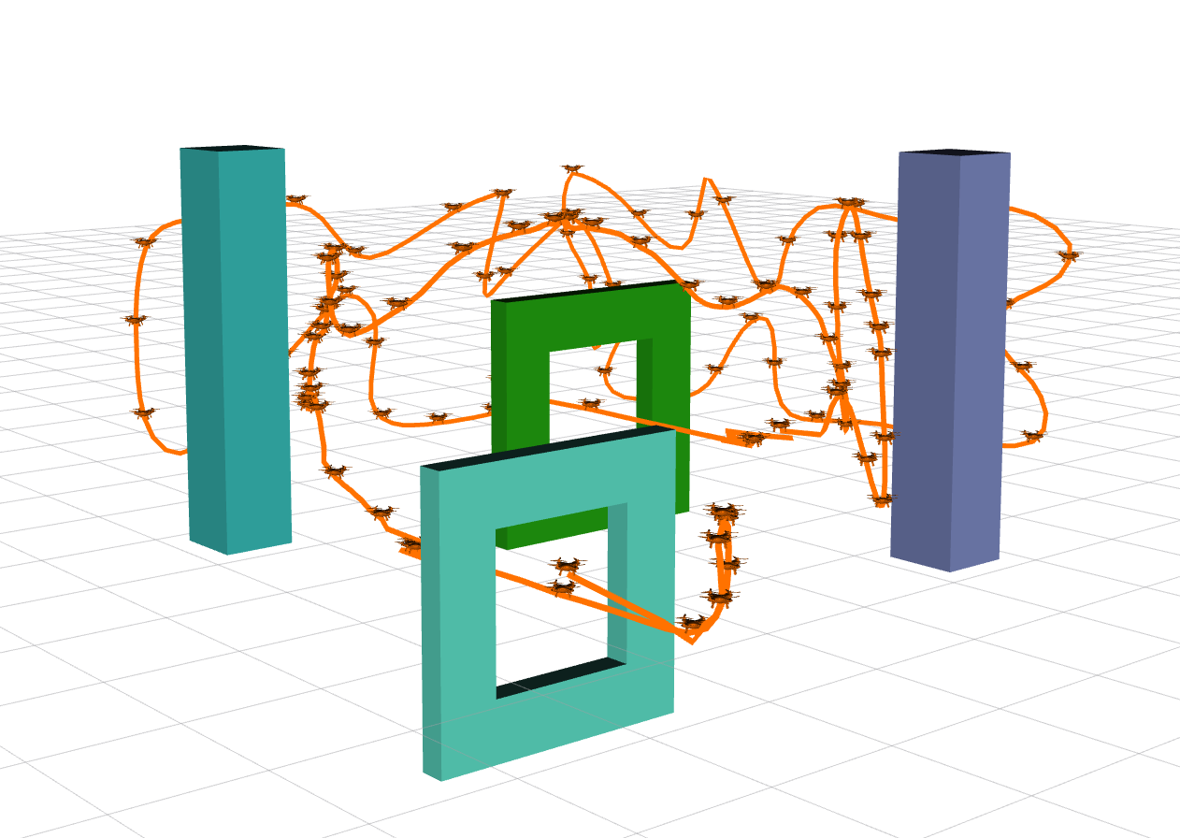
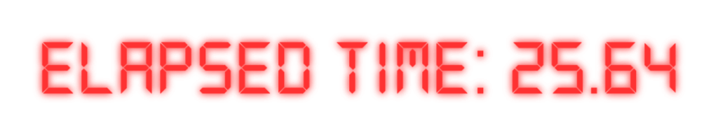
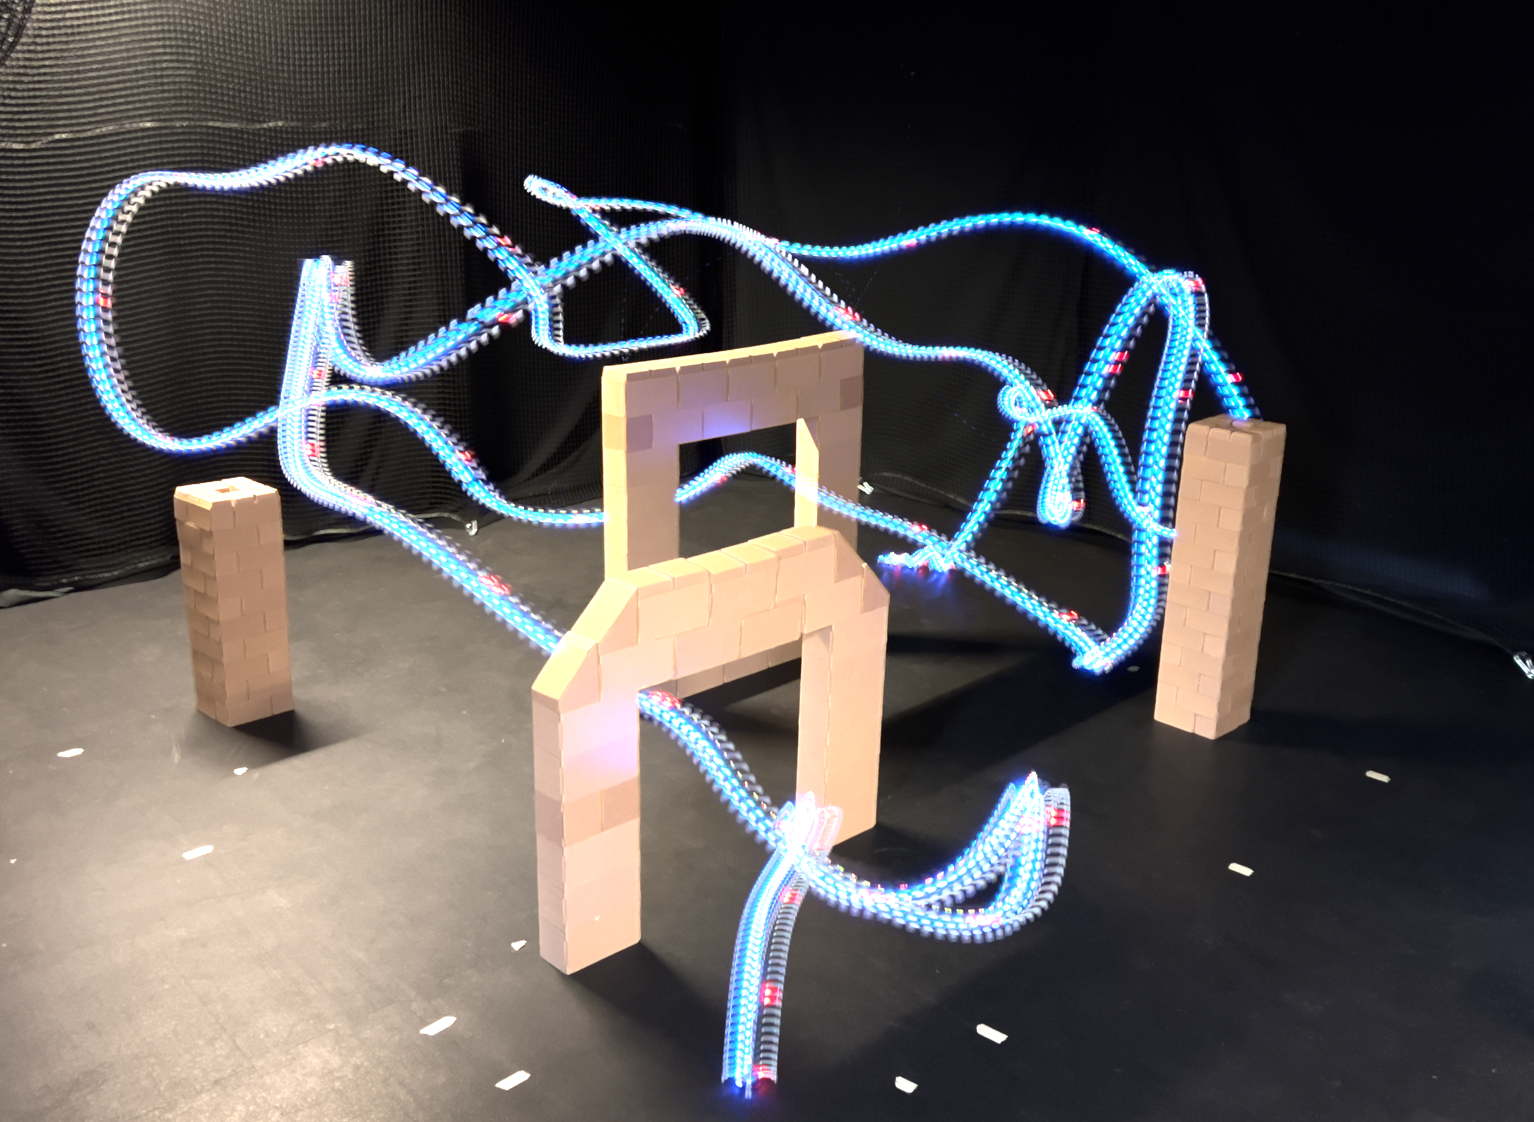
a) Time-Optimal Ergodic Trajectory in Complex Clutter
b) Trajectory Execution on Drone

